Slide 1
Exp-5
Static Code Analyzer
By
B Manikyala Rao M.Tech(Ph.d)
Assistant Professor
Dept of Computer Science & Engineering
Aditya College of Engineering & Technology
Surampalem

Slide 2
Sonarqube
What is Static Code Analysis?
Computer code that is performed without actually executing programs. Source code will be checked for compliance with a predefined set of rules or best practices set by the organization.
What is SonarQube?
Sonar is an open-source software quality platform. SonarQube saves the calculated measures in a database and showcases them in a rich web-based dashboard. Provides trends and leading indicators.

Slide 3
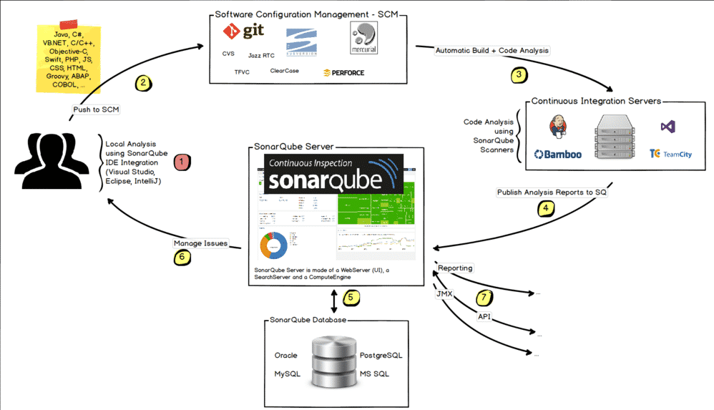
SonarQube CI

Slide 4
SonarQube Features
Supports languages: Java, C/C++, Objective-C, C#, PHP, Flex, Groovy, JavaScript, Python, PL/SQL, COBOL, etc. (note that some of them are commercial)
Can also be used in Android development.
Offers reports on duplicated code, coding standards, unit tests, code coverage, code complexity, potential bugs, comments, design, and architecture.
Records metrics history and provides evolution graphs (“time machine”) and differential views.
Provides fully automated analyses: integrates with Maven, Ant, Gradle, and continuous integration tools (Atlassian Bamboo, Jenkins, Hudson, etc.).
Integrates with the Eclipse development environment
Integrates with external tools: JIRA, Mantis, LDAP, Fortify, etc.
Is expandable with the use of plugins.

Slide 5
Sonarqube
Technical debt is caused by the 7 deadly sins of the developer:
Duplications: SonarQube has a copy/paste detection engine to find duplications
Bad distribution of complexity: Cyclomatic complexity
Spaghetti Design:Bad naming, Lack of patterns, Over abstraction
Lack of unit tests
No coding standards
Potential bugs
Not enough or too many comments or incorrect comments

Slide 6
SonarQube Installation on Docker
1.The first thing is to pull a docker image from using SonarQube's community edition docker image. Pull the docker image in your local machine by running this command:
docker pull sonarqube:8.2-community
2. Once you have this image in your local machine, run the following command to run the sonar-server inside a docker container.
docker container run -d -p 9000:9000 --name sonarserver SonarQube:8.2-community
3. This will start your sonar server on port 9000. After a few minutes, open the URL localhost:9000. There you will be asked to log in, and the default username and password is admin.

Slide 7
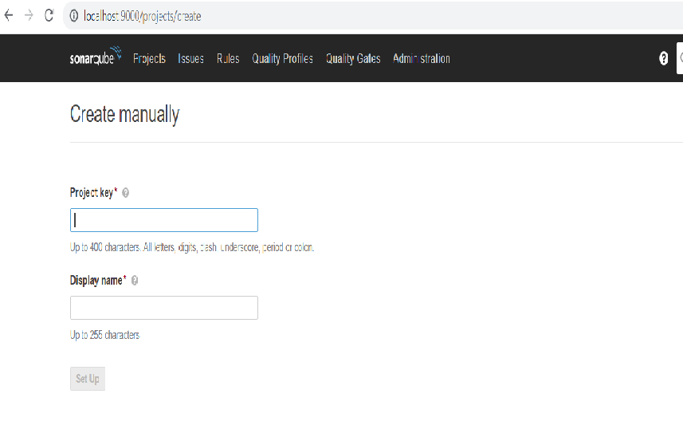
4. Once we're logged in to create a new project and analyze the source code, click on the + icon on the top right corner of the window and Enter your project key and display name, now you will need to generate a token for your project.

Slide 8
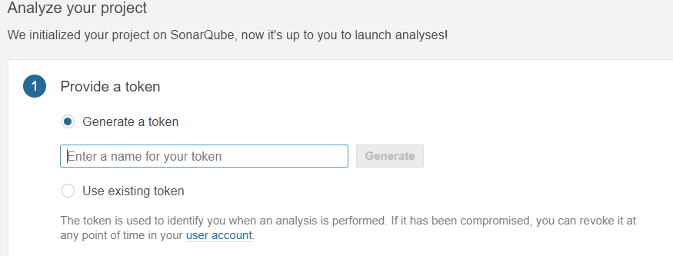

Slide 9
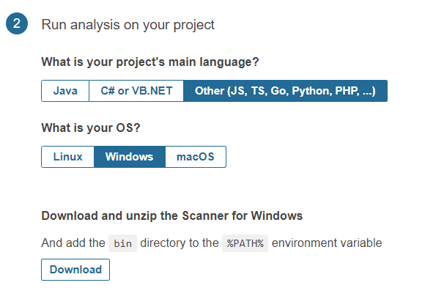

Slide 10
Execute the Scanner for Maven from your computer
Running a SonarQube analysis with Maven is straighforward. You just need to run the following command in your project's folder.
mvn sonar:sonar \ -Dsonar.projectKey=sam \ -Dsonar.host.url=http://localhost:9000 \ -Dsonar.login=6cf5a7debd7ca819b7e6130f0b324ea2ce3612bd

Slide 11
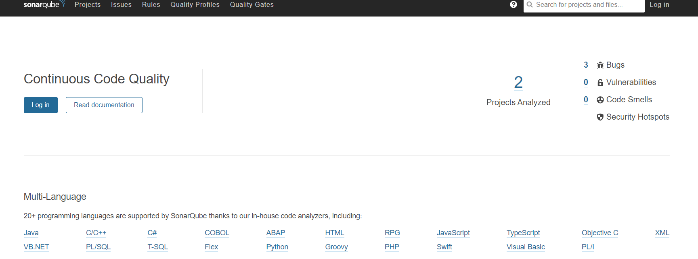

Slide 12
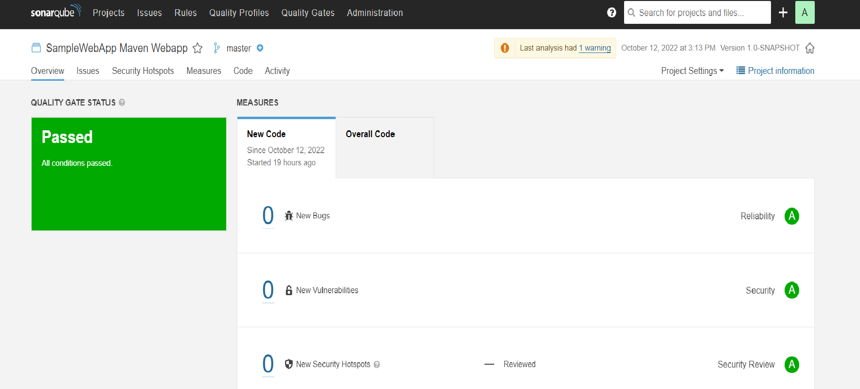

Slide 13


